Slide 1

ACROPOLIS INSTITUTE OF TECHNOLOGY AND RESEARCH
HAND GESTURE RECOGNIZATION USING WEBCAM
SUBMITTED BY
GUIDED BY
PROF. RONAK JAIN
ABHINAV DOGRE
ABHISHEK KUMAR DUBEY
ANKIT SAKARGAYEN
AYUSH KUMAR BOKADE
MANSI JAIN

Slide 2
INTRODUCTION
Computer technology has tremendously grown over the past decade and has become a necessary part of everyday live. The primary computer accessory for Human Computer Interaction (HCI) is the mouse.
Most laptops today are equipped with webcams, which have recently been used insecurity applications utilizing face recognition. In order to harness the full potential of a webcam, it can be used for vision based Computer Control, which would effectively eliminate the need for a computer mouse or mouse pad.

Slide 3
PROBLEM STATEMENT
The mouse is not suitable for HCI in some real life situations, such as with Human Robot Interaction (HRI).
There have been many researches on alternative methods to the computer mouse for HCI.
The most natural and intuitive technique for HCI, that is a viable replacement for the computer mouse is with the use of hand gestures

Slide 4
SURVEY OF EXISTING SYSTEM
Initially this technology was considered in the field of gaming (like Xbox Kinect), but the application of motion/gesture control technology would be more diverse if we apply it to our other electronics like computers ,televisions, etc., for our day to day purposes like scrolling , selecting, clicking etc

Slide 5
SOLUTION OF EXISTING SYSTEM
It is a device which recognizes hand gestures and can be used to virtually control a computer. In short, it provides a virtual screen with which we can interact with the computer. But the required hardware for making a device on these lines was not feasible, in terms of budget and time frame provided. So, we decided to build an introductory software implementation of the device which would eventually act as a virtual mouse.

Slide 6
PROBLEM DESCRIPTION
There are generally two approaches for hand gesture recognition, which are hardware based, where the user must wear a device, and the other is vision based which uses image processing techniques with inputs from a camera.
The proposed system is vision based, which uses image processing techniques and inputs from a computer webcam. Vision based gesture recognition tracking and gesture recognition. The input frame would be captured from the webcam and systems are generally broken down into four stages, skin detection, hand contour extraction, hand the skin region would be detected using skin detection.
The hand contour would then be found and used for hand tracking and gesture recognition.
Hand tracking would be used to navigate the computer cursor and hand gestures would be used to perform mouse functions such as swap right ,swap left,scroll up and scroll down. The scope of the project would therefore be to design a vision based Computer Control system, which can perform the mouse function previously stated.

Slide 7
ISSUES AND CHALLENGES
The first challenge was to correctly detect the hand with a webcam. We needed a Computer Vision library for this purpose. Many are available but we decided to go ahead with OpenCV^{[1]} as it is the most popular and has been ported to many languages and is supported on many operating systems from Android to Windows.
After learning OpenCV^{[1]}, We had to learn about the skin detection techniques and image processing techniques like Background Subtraction, Image Smoothening, Noise Removal and Reduction.

Slide 8
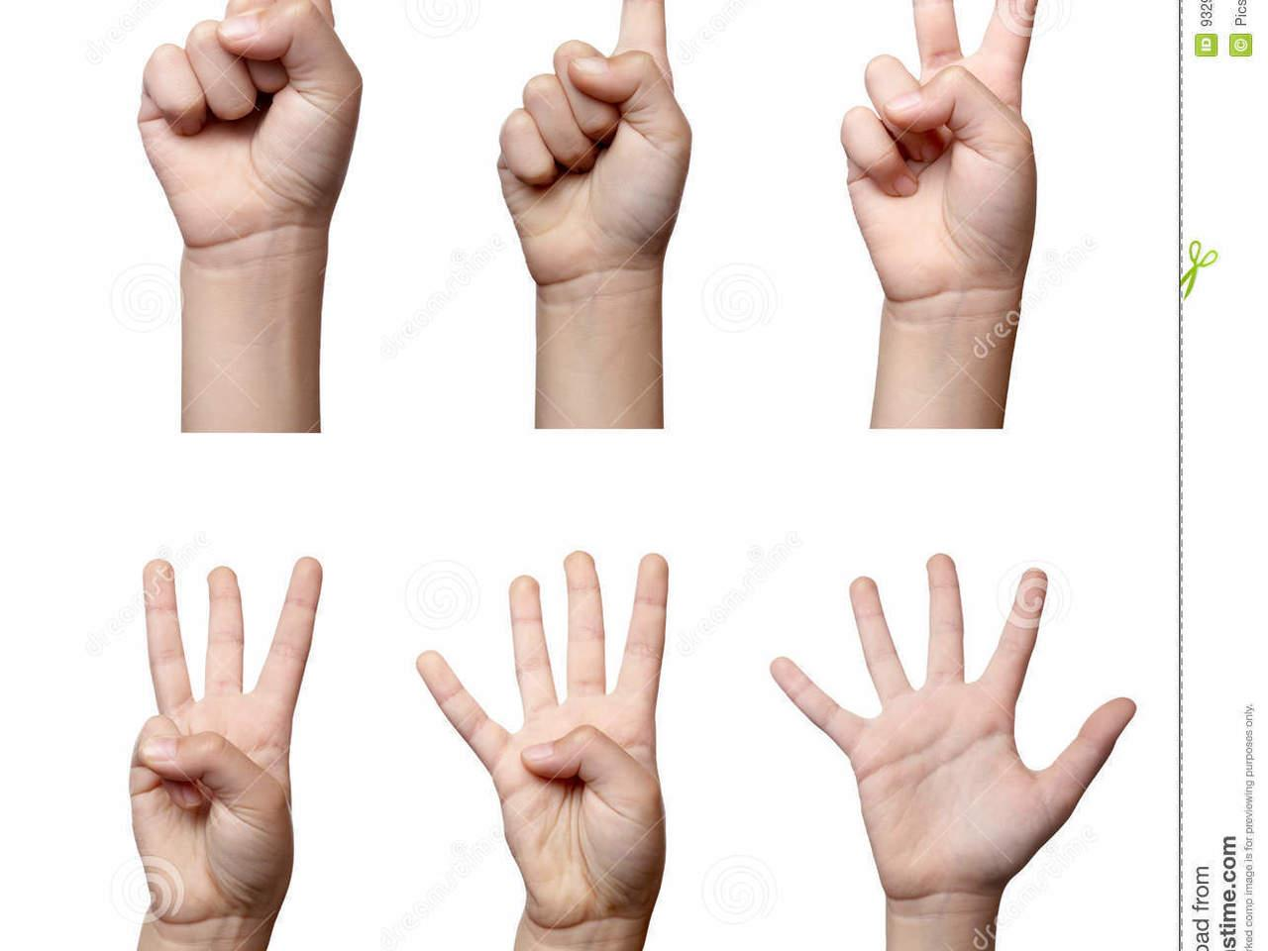

Slide 9
THANK YOU

